Slide 1
MIRL LAB Honours Project Bi-Weekly Update
MARL Crazyflie
Michael O’Sullivan, Aydin Yalcinkaya
Using MARL to learn safe take-off and hover policies for Crazyflie drones
CrazyFlie, MuJuCo, Gymnasium, PyTorch

Slide 2
Progress Recap
Goal: Implementing MARL algorithms for safe hovering and navigation on Crazyflie drones
Progress
  Base environment for training a single drone to hover at a target
  Single agent PPO-Clip applied to the target hover environment

Slide 3
Progress Since Last Meeting
Gymnasium environment set up for a basic hover task
MuJoCo simulation that renders the drone and target
PPO-Clip applied to a single drone for the hover task
Results
  Semi-successful policy resulting in imperfect hover behaviour
Challenges
  Tuning the environment and/or policy to optimize reward
    → Minimize oscillation about the target
  Inconsistent convergence on behaviour
    E.g. sometimes learns to oscillate target, stay on ground, or fly high up

Slide 4
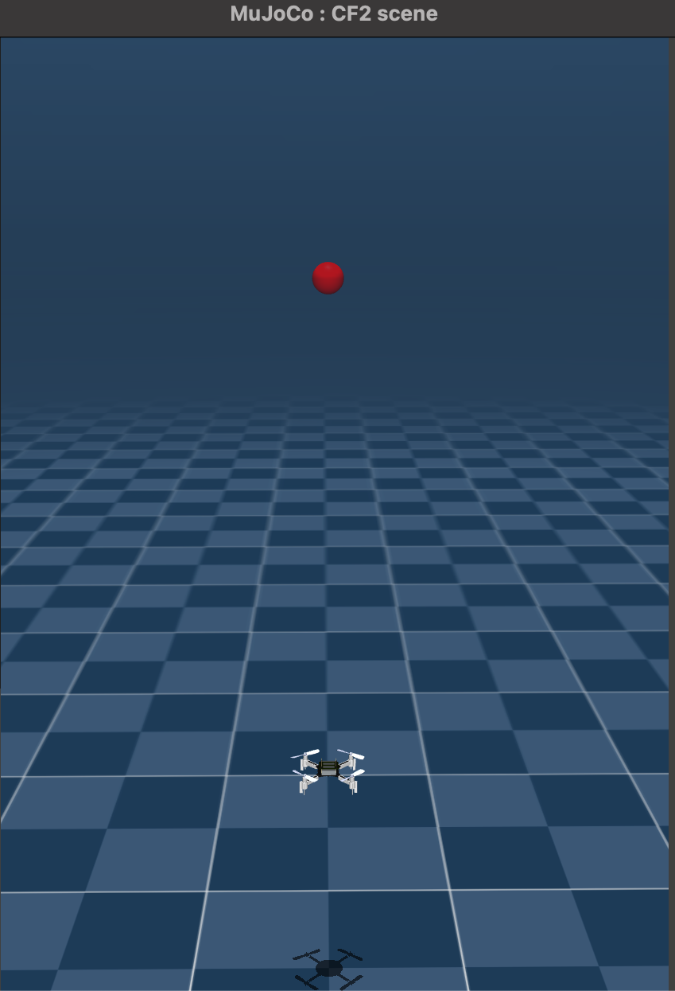
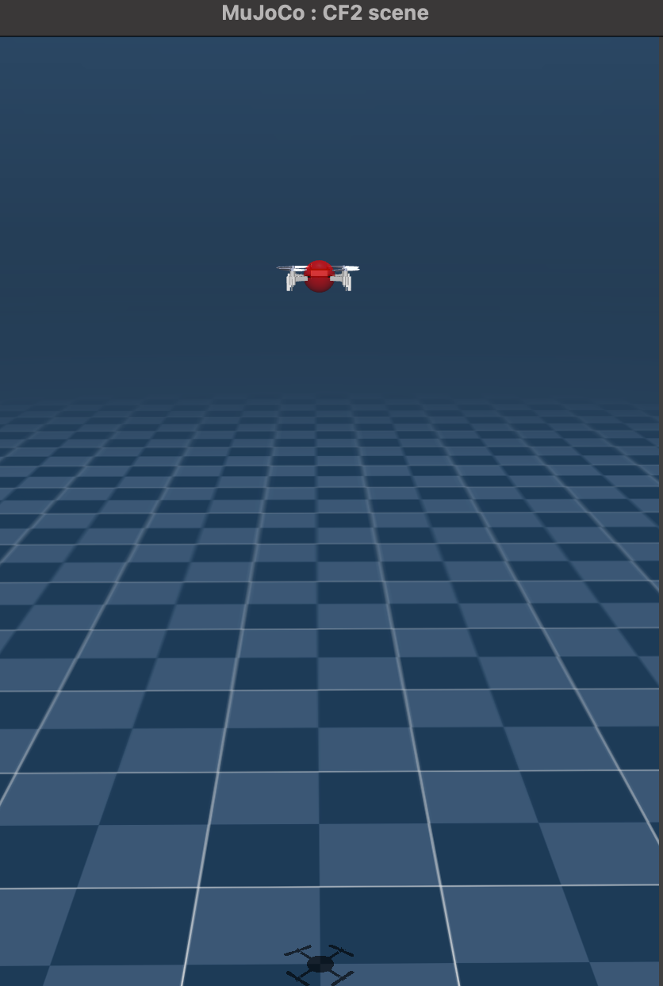
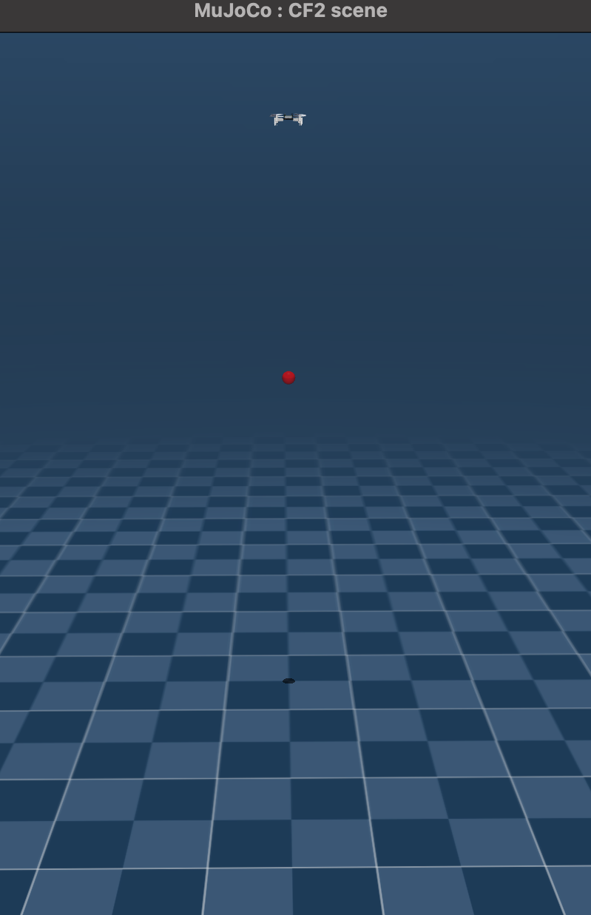
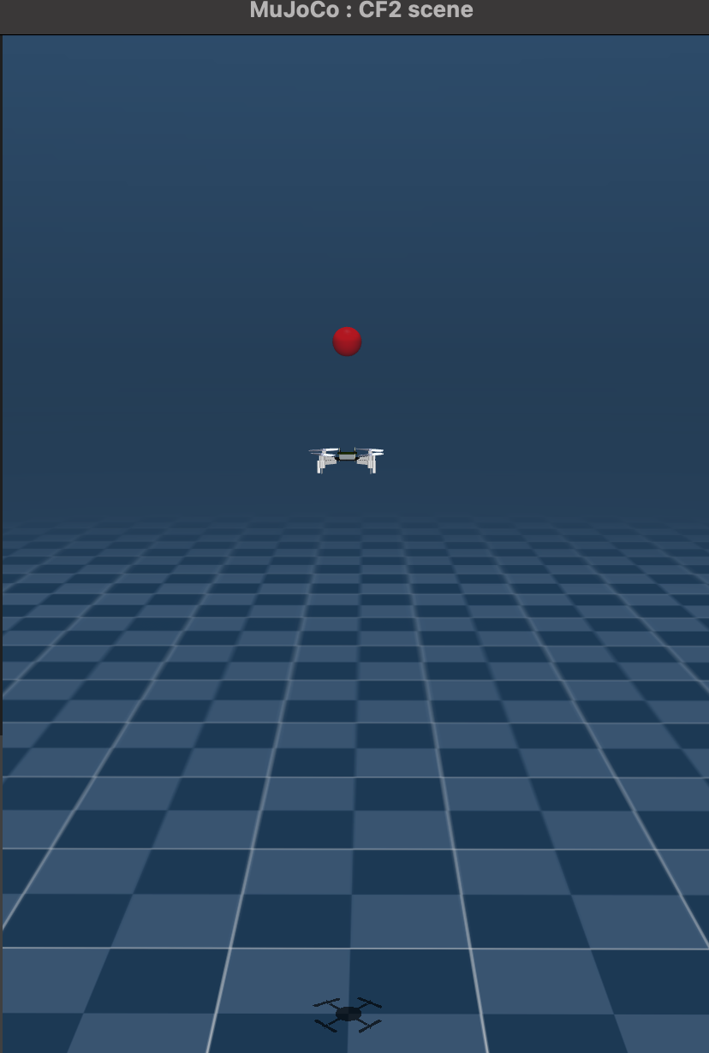
T = 1
T = 2
T = 3
T = 4
Current Goal: Hovering towards a target at [0, 0, 1] (thrust only)
Result: Oscillation about target (or gets stuck on ground / flies high)

Slide 5
Plan for the Next Two Weeks
Goals
  Learn a single drone to hover at a target in any [X, Y, Z]
    Perhaps hover at target T, then return to starting position and land
  Learn about MAPPO theory and implementation
Dependencies
  Researching / testing the parameters and current setup
    Need consistent behaviour convergence
    Need reduced oscillation

Slide 6
Roadmap Checkpoint
Week 2: Imperfect single agent hovering at target on Z axis
Week 4: Next milestone
Final deadline: Deliverables (e.g., report, demo, paper draft)
Note shifts in schedule here so I can track drift

Slide 7
Discussion Points / Questions
General feedback on the current setup (Main issue: Target Oscillation)
  Environment → Pure RL control (e.g. no thrust baseline)
    During training, drone initialized to random position on Z-axis [0, 0, Z]
    Reward based on distance improvement (reward += old distance - new distance)
    Episode termination based on N ~100 number of steps
  PPO-Clip
    Update policy every n ~1k steps, over N ~100k total timesteps
    Anneal learning rate linearly (fine-tune the policy, encourage exploration at start)
    Minibatches, KL-Divergence check, and Entropy bonus
  Plan
    Experiment with minor changes to the environment and/or policy
      I am working on a script to test different values across PPO / env parameters

Slide 8
Log Snapshot (Cumulative)
Date | Progress Summary | Next Steps | Notes
Sept. 16 | Set up MuJoCo sim; baseline PPO-Clip training | Refine current setup, explore MAPPO theory | Policy / env is current imperfect / inconsistent
Sept. 30

